Slide 1
Three Psalms of Lament
Northbrook Bible Chapel
Sunday AM, Dec 28, 2025
davidhansen.peng@gmail.com
Notes:
Psalms are poems, songs, and prayers all at once. “The Psalms cover everything that you could want to say to God; 3 simple but important things cover many of them “Please. Thank you. Sorry”. There are Wisdom, Penitential, Royal, Messianic, Kingdom, & Imprecatory Psalms, and also Psalms of Gratitude. There are eight Psalms of Lament out the 150, just three of the 8 for us this morning. Lament is not a very nice word. (Am I crazy for doing this on Dec 28?)
Causes of our lamenting: Self pity? (Can be healed but not indulged in, dare we come to God like that?) Disorientation? Illness? Under attack? Experiencing unfairness? Such things can disorient us (need of compass). When we forget which way is geographically correct it is an external matter, yet this is an internal word, we need the royal compass (the Bible)! Our spiritual disorientation is not because the King has moved!

Slide 2

NepaleseBuddhist
prayer
wheels
Matthew 6:7 But when ye pray, use not vain repetitions, as the heathen do, for they think that they shall be heard for their much speaking.

Slide 3

Japanese Shinto prayer
notes

Slide 4
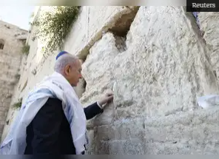
Netanyahu putting
a request in the Wailing Wall
Notes:
All of them completely silly? They at at least tell us something about humans, and the human heart with its vacuum. Furthermore, it was 3000 years ago that David penned the Psalms for the edification of the children of God onto a parchment (dried animal skin) and they read them. And here we are, still reading them. God preserved those psalms, those prayers, for a reason.

Slide 5
Luke 11 ¹ And it came to pass that, as He was praying in a certain place, when He ceased, one of his disciples said unto Him, Lord, teach us to pray, as John also taught his disciples.
Romans 8 ²⁶ Likewise the Spirit also helpeth our infirmities for we know not what we should pray for as we ought, but the Spirit maketh intercession for us with groanings which cannot be uttered.
Notes:
The extremes in church services mirror the extremes in prayer seen in Christendom, from the passionate service (lively, unpredictable, disorderly, maybe wild – not good – lots of flame but what colour is it) to the very formal church service (repetitious, boring, stone dead – not good – no flame at all). The same is true of prayer, humans range from the use of chaotic spontaneous prayer (sometimes at the expense of coherence – no one being sure about what was said) to the sole use of rote prayers read as a set pieces for that Sunday in the religious calendar (thus becoming lifeless recitations). One end of the spectrum says more emotions bring greater spiritual power with God (NO), the other seems to believe in sequences of magic words, incantations that will bring automatic attention from God (NO – the Bible is not a book of ‘spells’ that we use with a magic wand). Both extremes are expressions, or outworkings, of human inadequacy (though in different aspects of it). But in them we see our own tendencies & inadequacies too. Are we prone to seeking the emotional? Are we prone to coldness? Do our minds wander? We find in the scriptures that our inadequacies are not new. The disciples said “Teach us to pray” (Luke 11) and the Lord gave them the Lord’s prayer as a guide (before the Holy Spirit was given). Paul referred to “our” infirmities (Romans 8) and declared that “we” don’t know how to pray – so we may say that he included his own human condition when it came to weakness in prayer (though he was such a man of God). The Bible is given to such as ourselves, He gave it to us because “He knows our frame, He remembers that we are dust.” Ps 104:13 The Romans passage teaches us that God’s Spirit works with us.

Slide 6
Psalms of Lament
3, 6, 10, 13,
22, 38, 42, 88
Notes:
We also have corporate expressions of sufferings & pleas for deliverance in Ps 44, 60, 74, 79, & 80.
Do you have a post-it note on your night table that you may glance at, so as to be reminded of that dear one’s pain or another’s need? The lament, however, comes fromWITHIN.

Slide 7
Psalms of Lament
1. Cry
2. Complaint
3. Connection
4. Petition
5. Look to the Future
Notes:
ALSO: Past (immediate past, led to the Cry), Present (this moment before God) and Future (look ahead).
The 8 laments have the above approximate pattern, as if David is implying “I have been here before and I know it.” Have you ‘been here before’ when you kneel and pray? Does it cause you heaviness (to know that you have been here before)? Heaviness at least means that you are alive and that you care.

Slide 8
Psalms of Lament
3, 13, 42
Notes:
Three for this morning.

Slide 9
1. The Cry
to God
Notes:
Bottled up from ‘past’ or recent events,
now coming out in an ‘inarticulate’ and very ‘succinct’ manner. That is ok with God.

Slide 10
PSALM 3 ¹Lord, …
PSALM 13 ¹How long wilt thou forget me, O Lord? Forever? How long wilt thou hide thy face from me?
PSALM 42 ¹As the deer panteth after the water brooks, so panteth my soul after thee, O God. ² My soul thirsteth for God, for the living God: when shall I come and appear before God?
Notes:
Ps 3: This perhaps after having just enough strength to call out “LORD” you have a long pause (and tears). Know that the Lord Jesus heard your cry. Know that He sees every tear.
Ps 13: No apparent concern with offending God. Genuine.
Ps 42: A positive start but also a statement of the reality of our condition on earth (until our physical redemption). When indeed.

Slide 11
2. The Complaint
Notes:
Seems to be a very unspiritual thing to do. But maybe for 2026 we should decide never to complain to men and only to God.
My father was not an emotional man but used to sometimes say “What’s eating YOU?” Indeed, things can be “eating” us! And yes, sometimes others see it going on in us when we do not. (Is it because we do not want to admit it to ourselves? When Dad was right (always the case) was when I hated when he said that.)

Slide 12
PSALM 3 ¹(Lord) how they are increased that trouble me! Many are they that rise up against me. ²Many there be which say of my soul “There is no help for him in God.” Selah.
Notes:
Trouble trouble trouble …. 55 times in the Psalms
Jn 16:33 KJV “These things I have spoken unto you, that in Me ye might have peace. In this world you shall have trouble (tribulation) but be of good cheer, I have overcome the world.” David has not overcome, Jesus has.

Slide 13
PSALM 13 ²How long shall I take counsel in my soul, having sorrow in my heart daily? How long shall mine enemy be exalted over me?
Notes:
Repeat “How long, how long, how long…. ” - yes 15 times in the Psalms. Did I start to irritate you with that? Jesus said to knock on the door of the judge in the middle of the night (Luke 18), which we would certainly dare not do, to door on the personal home of a NS magistrate. BE importunate in prayer (think of the port root, meaning opening in the coastline or door, we know the word opportunity very well, ob meaning toward). Be importunate toward the Judge of all the earth.

Slide 14
PSALM 42 ³ My tears have been my meat day and night, while they continually say unto me, Where is thy God?
Notes:
Tears – what an odd ‘food’. One, it seems, that we humans must have in our diet sometimes.

Slide 15
3. ‘Connection’
(often a ‘Reminder to Self’, a Confession, or an Expression of Trust)
Notes:
Remember the happy sound when the fax machine made the connection? Aaaah…the smell of white-out and the singing of the fax machine (not flowers and birds but….) ! It was a reassuring sound. You are ‘on-line’ with God now and you know it! The cry was just a cry. Maybe a bit ashamed of your complaint? You’re ‘on-line’ now! The soul connection can be a confession. The soul connection can be expression of trust or an acknowledgement of Who is in control.

Slide 16
Psalm 3 ³But thou O Lord art a shield for me, my glory and the lifter up of mine head.
Psalm 13 ⁵But I have trusted in thy mercy …
Notes:
We had (1) The Cry …. then (2) The Complaint….
now as we start (3) The Connection …. two of our lament Psalms start with BUT…. (Good! Not stuck in swamp of Crying & Complaining).
CONNECTION via ….. ‘Reminder to self’ of realities - invisible shield, invisible touch (Psalm 3).
Sometimes Mom would say “Chin up!” and literally lift up my chin.
CONNECTION via ….. ‘Reminder to self’ of past trusting (Psalm 13). (How forgetful we are!)

Slide 17
Psalm 42 ⁴ When I remember these things, I pour out my soul in me. For I had gone with the multitude, I went with them to the house of God, with the voice of joy and praise, with a multitude that kept holy days. ⁵ Why art thou cast down, O my soul? And why art thou disquieted in me? Hope thou in God….
Notes:
COMFORT HAS COME! Interesting that David remembers that he had the blessing of going to church. Maybe he stopped going and is asking himself why he had done that (stopped). David seems to be confessing something to himself, but before God. David asks himself questions (soul searching), but before God. David seems to instruct himself, but with God listening in.

Slide 18
4. The Petition

Slide 19
Psalm 3 ⁴I cried unto the Lord with my voice and he heard me out of his holy hill. Selah. ⁵I laid me down and slept, I awaked for the Lord sustained me.
Notes:
No details of the need are expressed here in human words (as per Romans 8) here in this Ps 3 petition, but the audible crying brings a wonderful result: ‘Now I can sleep.’ Not the sleep of death (see Ps 13), not utter insensibility, this kind of Psalm 3 sleep is the wonderful sleep of the heart and mind that is at peace.

Slide 20
Psalm 13 ³Consider and hear me, O Lord my God: lighten mine eyes, lest I sleep the sleep of death; ⁴Lest mine enemy say, I have prevailed against him; and those that trouble me rejoice when I am moved.
Notes:
Three Potential Problems presented here:
Eyes that ‘see’ darkness? Not good.
Sleep that is death? Not good.
Enemies that prevail? Not good.
ALL SUCH ARE BROUGHT TO GOD.

Slide 21
Psalm 42 ¹⁰ As with a sword in my bones mine enemies reproach me;
while they say daily unto me ‘Where is thy God’ ?
Notes:
Psalm 42 here has two implied ‘petitions’, situations that should not be allowed to continue, unresolved:
(1) a matter involving pain. What kind? Which one is in fact the worse, spiritual pain or physical pain?
(2) a matter involving humiliation, know that our God is One who is concerned with honour.

Slide 22
5. The Look to
the Future.
Notes:
Laments often end with some kind of ‘VOW’ or expression of godly determination. Note: David has ‘been here before’ as well. (Trying again?)
* Avoid New Year’s Resolutions. We live by grace. Our strength and hope are in the Lord.
WHAT WILL YOUR 2026 BE LIKE ?? WHAT DO YOUWANT IT TO BE LIKE? WHAT IS YOUR HEART’S DESIRE? GROW IN GRACE?
* Let us consider a few closing verses to Laments, some reminders of ‘options’.

Slide 23
Psalm 3 ⁶I will not be afraid
of ten thousands of people
that have set themselves
against me round about.
Notes:
I WILL NOT BE AFRAID. By the grace of God I choose not to be paralysed.

Slide 24
Psalm 13 ⁵But I have trusted in thy mercy my heart shall rejoice in thy salvation. ⁶I will sing unto the Lord, because he hath dealt bountifully with me.
Notes:
I WILL SING. “…Singing and making melody in your heart to the Lord” (Eph 5:19). Not so difficult right? Especially here with others! And don’t forsake the assembling of yourselves together but encourage one another, and so much the more as ye see the day approaching (Heb 10:25).

Slide 25
Psalm 42 ¹¹ Why art thou cast down, O my soul? And why art thou disquieted within me?
Hope thou in God, for I shall yet praise Him, who is the health of
my countenance, and my God.
Notes:
I WILL PRAISE. Odd to ‘promise’ to praise? Like many things within the Christian experience (such as faith), praise is partly from the heart and partly from the head. (Praise will also help you keep your head.)

Slide 26
Do you ever say “Lord Jesus teach me to pray?”
Do you ever say “Holy Spirit, help me to pray”?”
Notes:
We well know about mental discipline in learning. We know about physical discipline in weight lifting. Why do we tend to discount the idea of spiritual discipline(s)?
Asking a Luke 11? No? Why not? Are you trying? Are you not a disciple?
Asking a Romans 8? Do you not have need of God’s Holy Spirit?
May 2026 be different for you and for me.

Slide 27
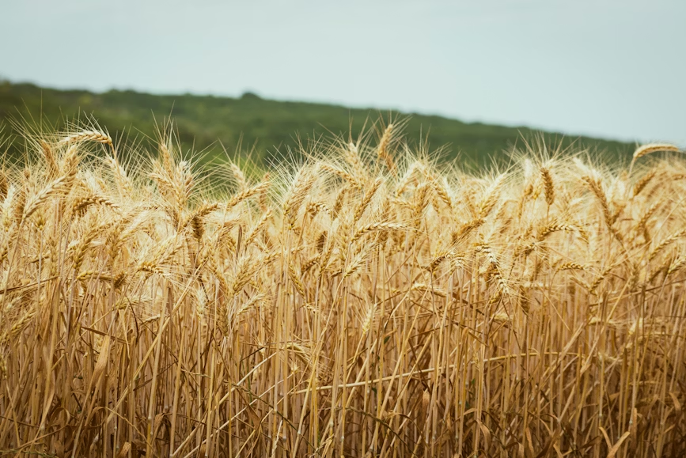
John 4:35 Say not ye, There are yet four months, and then cometh harvest? Behold, I
say unto you, lift up your eyes and look on the fields, for they are white already to harvest.
Notes:
We of all people should know that the role of perception is great.

Slide 28


